Slide 1


IBA MS Data Science
Big Data Analytics 2022
Big Data Analytics
Docker Hive Project
This project is created on a Docker Image of Apache Hive.
Creating a multi node environment of these containers.
This project is being followed from the initialization process of starting HIVE containers to handle large dataset
Created By
Fareed Hassan Khan
ERP 25367

Slide 2

IBA MS Data Science
Big Data Analytics 2022
Tools for Presentation
IBM Watson Text to Speech Converter
Convert text into natural-sounding speech in a variety of languages and voices
Microsoft PowerPoint
Microsoft PowerPoint is a presentation program, created by Robert Gaskins and Dennis Austin
C
Clipchamp Video Editor
Clipchamp is now our go-to video creation and editing suite.

Slide 3
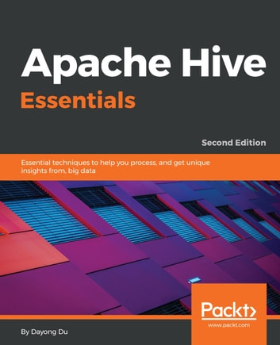
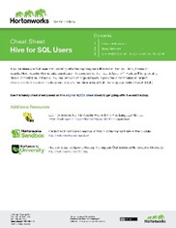
IBA MS Data Science
Big Data Analytics 2022
Project Resources
Apache Hive Essentials
Essential techniques to help you process, and get unique insights from, big data, 2nd Edition.
by Dayong Du
Cheat Sheet - Hive for SQL Users
Use this handy cheat sheet (based on this original MySQL cheat sheet) to get going with Hive and Hadoop
by HortonWorks

Slide 4
IBA MS Data Science
Big Data Analytics 2022
Project Distribution
Project
Initial Process
Apache HIVE guide
Working with Big Data
Containers Initialization
Handling Data Types
Copying Big Data
Bridge Networking
Databases
Creating Tables
Tables
Insights Flights Data
Partitions
…
Hivemall

Slide 5
IBA MS Data Science
Big Data Analytics 2022
Dataset Description
Employee Data
Contains some basic information's about employees in text file.
Employee Data with ID
Contains some basic information's about employees with their ids in text file.
United States Flights – Big Data
Contains US domestics flights information.

Slide 6
IBA MS Data Science
Big Data Analytics 2022
Initializing Hive Container
Cloning GitHub Repository
git clone https://github.com/big-data-europe/docker-hive.git
Folder Structure
Composing yml file
│ .gitignore
│ docker-compose.yml
| …
│ startup.sh
│
└───conf
beeline-log4j2.properties
…
llap-daemon-log4j2.properties
docker-compose up –d

Slide 7
IBA MS Data Science
Big Data Analytics 2022
Structure of Compose.yml File
version: "3" services:
namenode:
image: bde2020/hadoop-namenode:2.0.0-hadoop2.7.4-java8
…
datanode:
image: bde2020/hadoop-datanode:2.0.0-hadoop2.7.4-java8
…
hive-server:
image: bde2020/hive:2.3.2-postgresql-metastore
…
hive-metastore:
image: bde2020/hive:2.3.2-postgresql-metastore
…
hive-metastore-postgresql:
image: bde2020/hive-metastore-postgresql:2.3.0
…
Name Node
Data Node
Hive Server
Hive Metstore
hive-metastore-postgresql

Slide 8
IBA MS Data Science
Big Data Analytics 2022
Bridge Networking of Containers
network connect docker-hive_default docker-hive_namenode_1
Name Node
network connect docker-hive_default docker-hive_datanode_1
Data Node
network connect docker-hive_default docker-hive_hive-server_1
Hive Server
network connect docker-hive_default docker-hive_hive-metastore_1
Hive Metstore
network connect docker-hive_default docker-hive_hive-metastore-postgresql_1
hive-metastore-postgresql

Slide 9
IBA MS Data Science
Big Data Analytics 2022
Basic Guide of Apache Hive
Handling Data Types
Databases
Tables
Partitions
Buckets
Views
Performance Utilities
Logs
Marks and Encryption
Hivemall

Slide 10
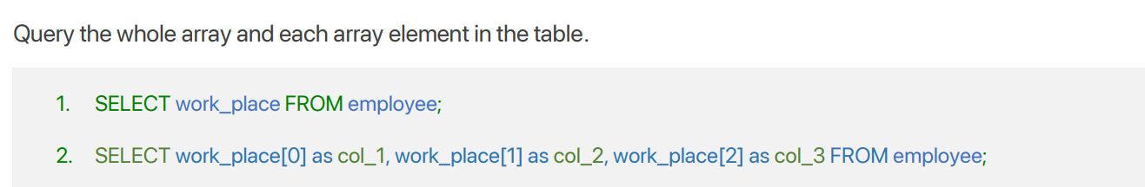
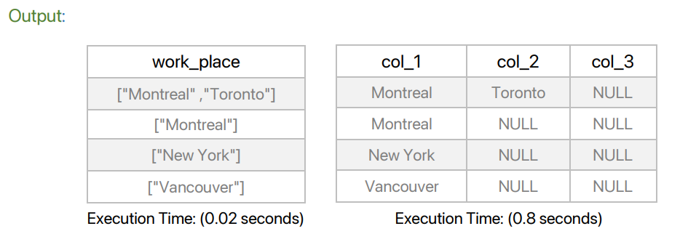
IBA MS Data Science
Big Data Analytics 2022
Basic Guide of Apache Hive
Handling Data Types
Databases
Tables
Partitions
Buckets
Views
Performance Utilities
Logs
Marks and Encryption
Hivemall

Slide 11
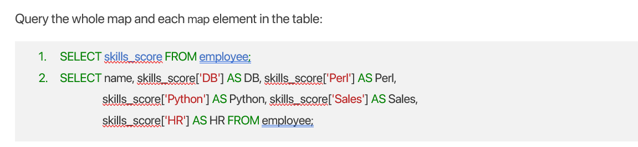
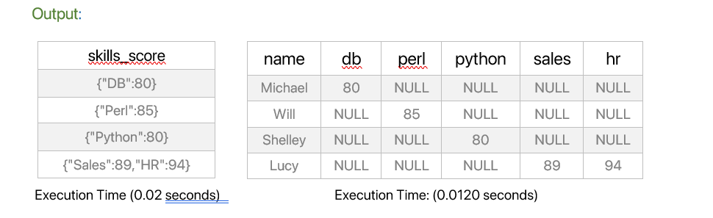
IBA MS Data Science
Big Data Analytics 2022
Basic Guide of Apache Hive
Handling Data Types
Databases
Tables
Partitions
Buckets
Views
Performance Utilities
Logs
Marks and Encryption
Hivemall

Slide 12
IBA MS Data Science
Big Data Analytics 2022
Basic Guide of Apache Hive
Handling Data Types
Using the database name myhivebook
Databases
USE myhivebook;
Tables
Describing the database named default
Partitions
describe database default;
Buckets
Selecting current database
Views
SELECT current_database();
Performance Utilities
Editing database properties
Logs
…
Alter database myhivebook set dbproperties ('edited-by'='fareed');
Marks and Encryption
Hivemall

Slide 13
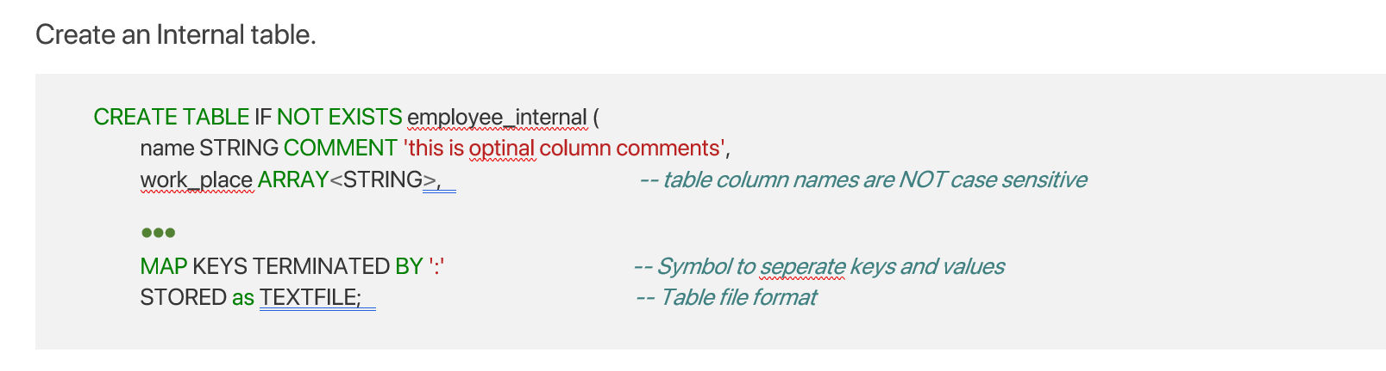
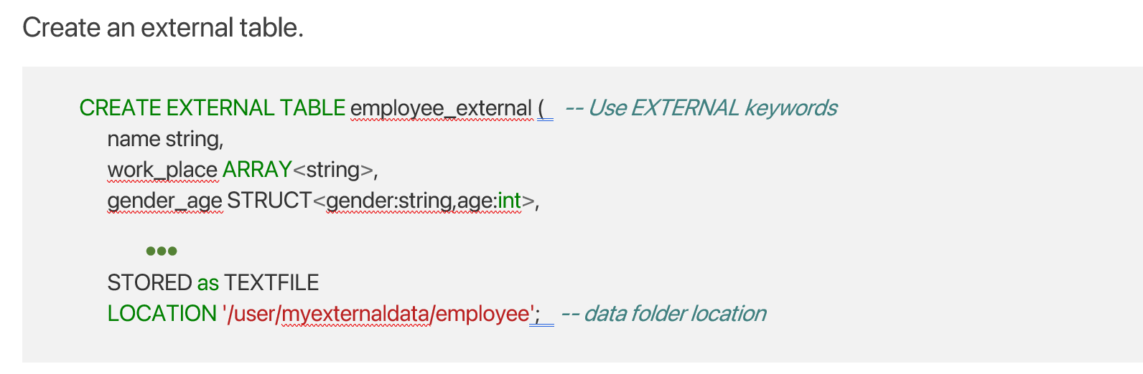
IBA MS Data Science
Big Data Analytics 2022
Basic Guide of Apache Hive
Handling Data Types
Databases
Tables
Partitions
Buckets
Views
Performance Utilities
Logs
Marks and Encryption
Hivemall

Slide 14
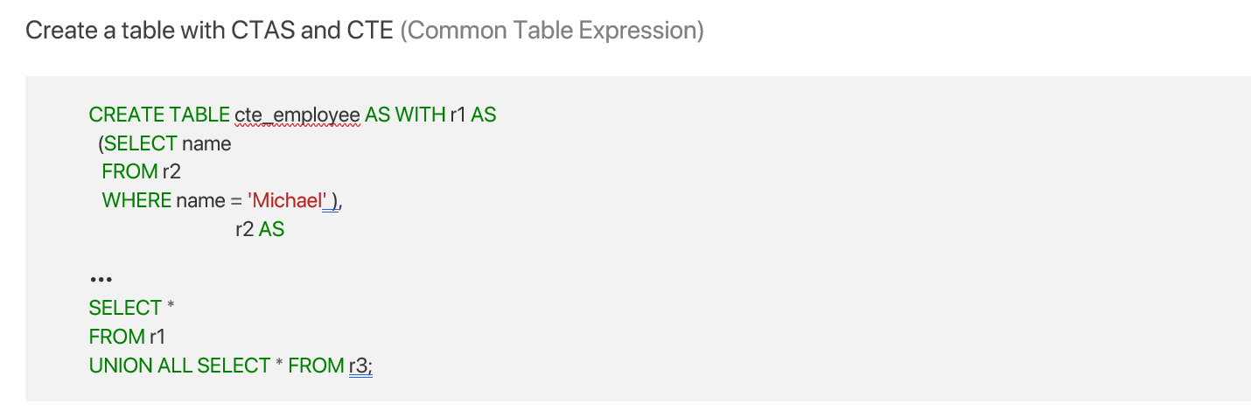
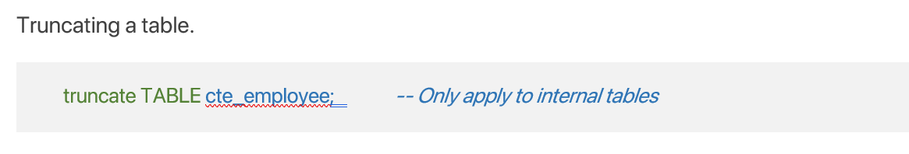
IBA MS Data Science
Big Data Analytics 2022
Basic Guide of Apache Hive
Handling Data Types
Databases
Tables
Partitions
Buckets
Views
Performance Utilities
Logs
Marks and Encryption
Hivemall

Slide 15

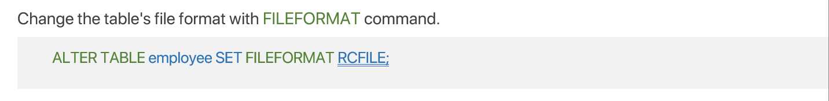
IBA MS Data Science
Big Data Analytics 2022
Basic Guide of Apache Hive
Handling Data Types
Databases
Tables
Partitions
Buckets
Views
…
Performance Utilities
Logs
Marks and Encryption
Hivemall

Slide 16
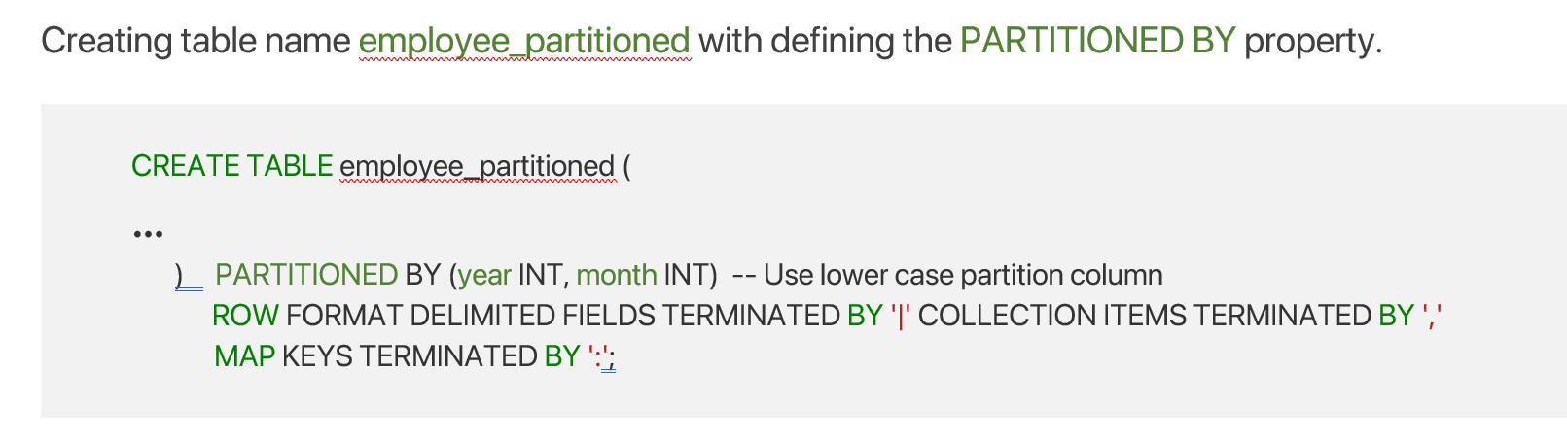
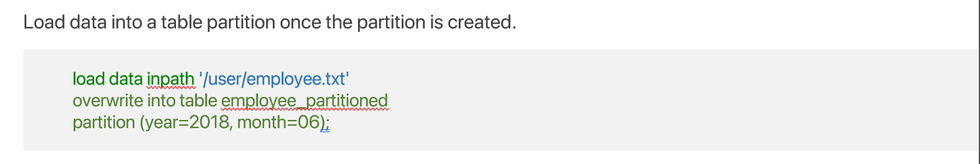
IBA MS Data Science
Big Data Analytics 2022
Basic Guide of Apache Hive
Handling Data Types
Databases
Tables
Partitions
Buckets
Views
Performance Utilities
Logs
Marks and Encryption
Hivemall

Slide 17
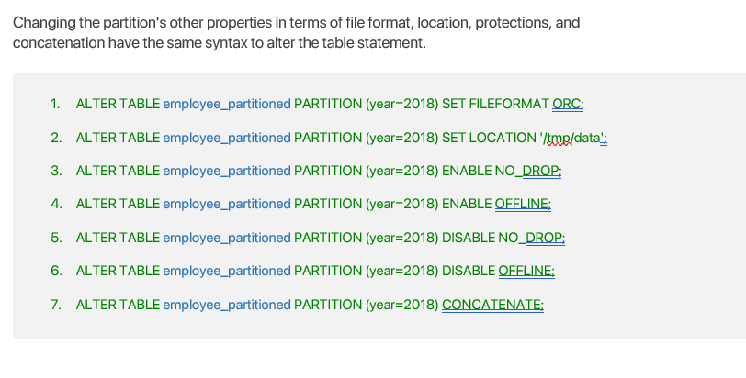
IBA MS Data Science
Big Data Analytics 2022
Basic Guide of Apache Hive
Handling Data Types
Databases
Tables
Partitions
Buckets
Views
Performance Utilities
…
Logs
Marks and Encryption
Hivemall

Slide 18
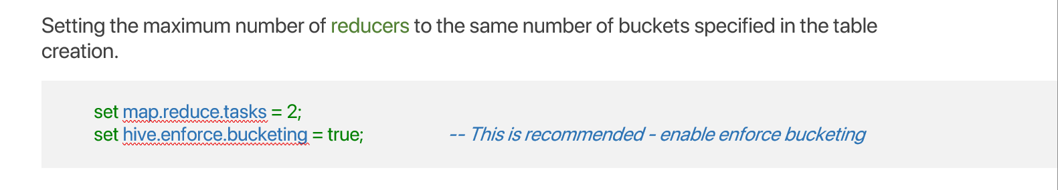

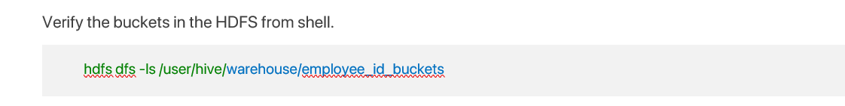
IBA MS Data Science
Big Data Analytics 2022
Basic Guide of Apache Hive
Handling Data Types
Databases
Tables
Partitions
Buckets
Views
Performance Utilities
Logs
…
Marks and Encryption
Hivemall

Slide 19
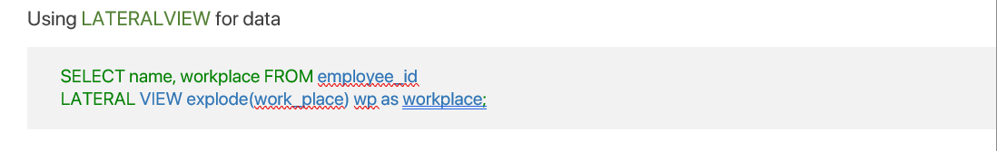


IBA MS Data Science
Big Data Analytics 2022
Basic Guide of Apache Hive
Handling Data Types
Databases
Tables
Partitions
Buckets
Views
Performance Utilities
…
Logs
Marks and Encryption
Hivemall

Slide 20
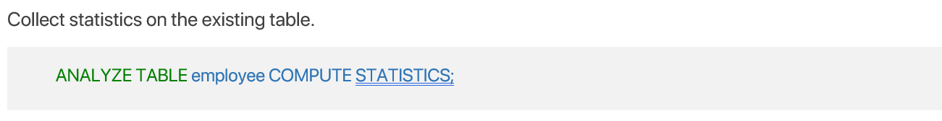
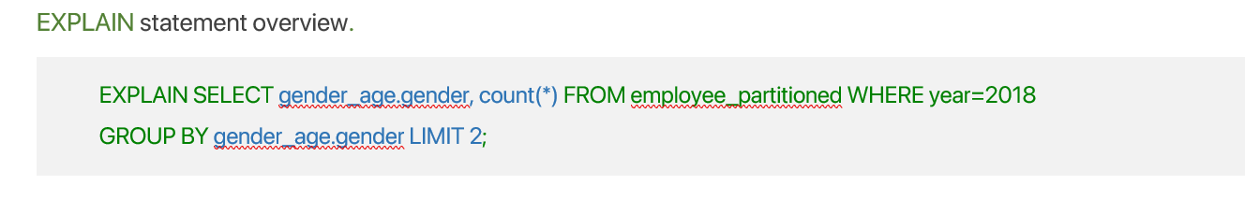

IBA MS Data Science
Big Data Analytics 2022
Basic Guide of Apache Hive
Handling Data Types
Databases
Tables
Partitions
Buckets
Views
Performance Utilities
Logs
…
Marks and Encryption
Hivemall

Slide 21
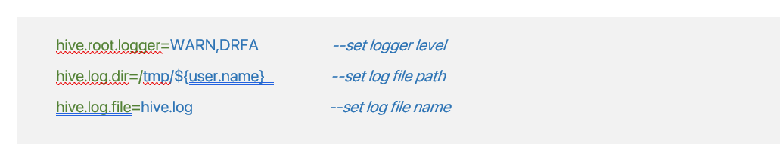
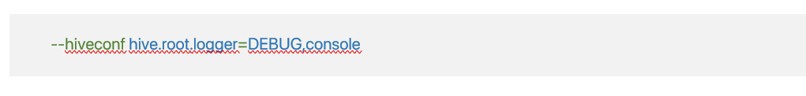
IBA MS Data Science
Big Data Analytics 2022
Basic Guide of Apache Hive
Handling Data Types
Databases
Tables
Partitions
Buckets
Views
…
Performance Utilities
Logs
Marks and Encryption
Hivemall

Slide 22
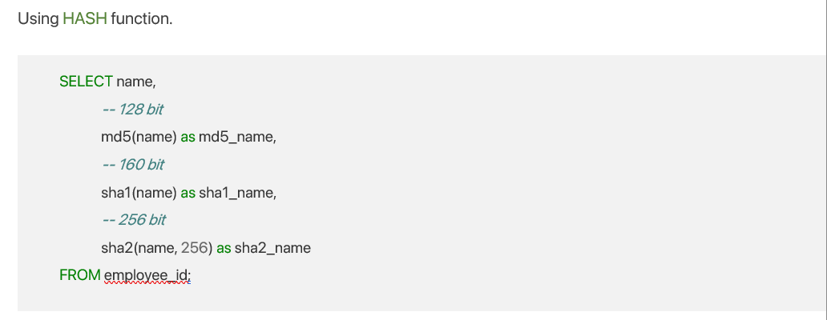
IBA MS Data Science
Big Data Analytics 2022
Basic Guide of Apache Hive
Handling Data Types
Databases
Tables
Partitions
Buckets
Views
Performance Utilities
Logs
Marks and Encryption
Hivemall

Slide 23
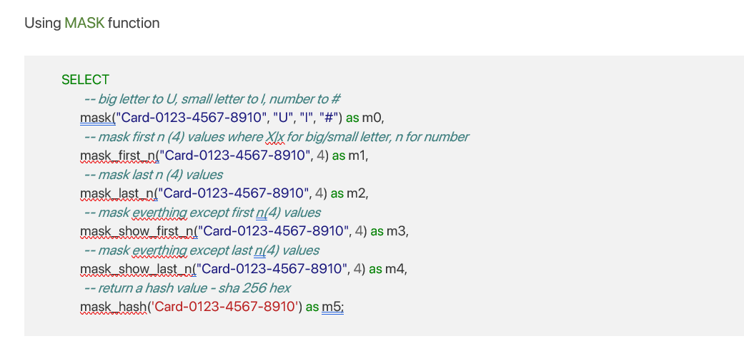
IBA MS Data Science
Big Data Analytics 2022
Basic Guide of Apache Hive
Handling Data Types
Databases
Tables
Partitions
Buckets
Views
Performance Utilities
Logs
Marks and Encryption
Hivemall

Slide 24

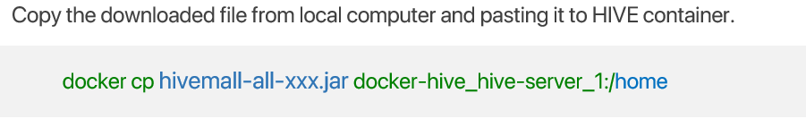
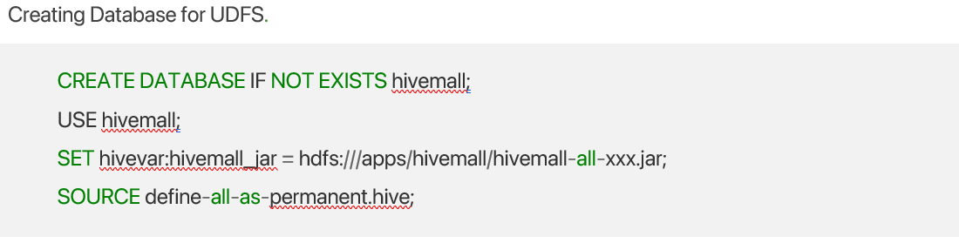
IBA MS Data Science
Big Data Analytics 2022
Basic Guide of Apache Hive
Handling Data Types
It contains several ML algorithm implementations
Databases
Tables
Steps to set it up
Partitions
Buckets
Views
Performance Utilities
Logs
…
Marks and Encryption
Hivemall

Slide 25

IBA MS Data Science
Big Data Analytics 2022
Working with Big Data
Flights Dataset 2009 - 2018
United States Domestic Flights from 2009 to 2018
Filesize of the dataset
7 GB.
Shape of the Dataset
62 million US Domestic Flights
Dataset File format
CSV (comma Separated File)
Dataset Source
Kaggle

Slide 26

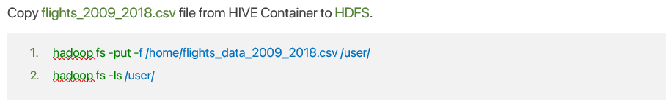
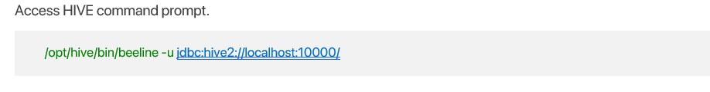
IBA MS Data Science
Big Data Analytics 2022
Working with Big Data
Load Flights data to hive container/HDFS
…

Slide 27
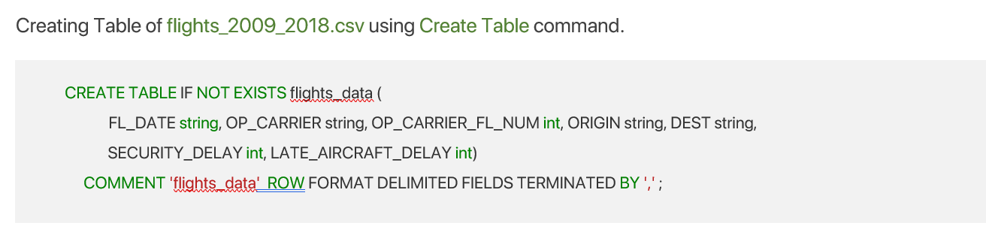


IBA MS Data Science
Big Data Analytics 2022
Working with Big Data
Creating Tables of Flights data
…

Slide 28
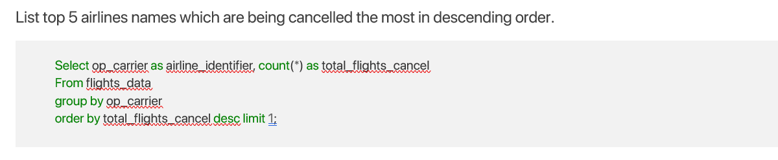
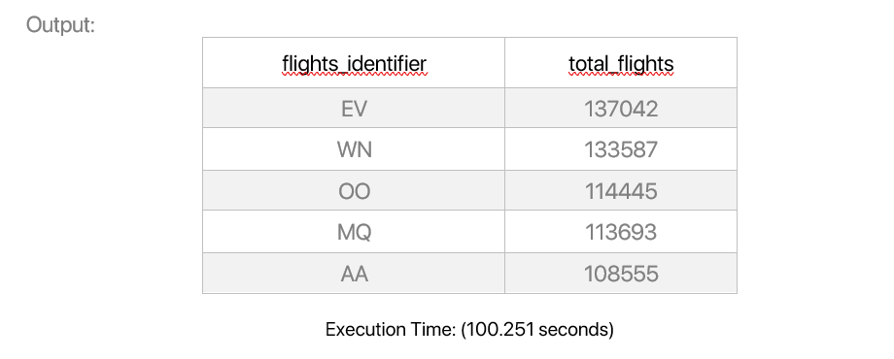
IBA MS Data Science
Big Data Analytics 2022
Working with Big Data
Insights of Data

Slide 29
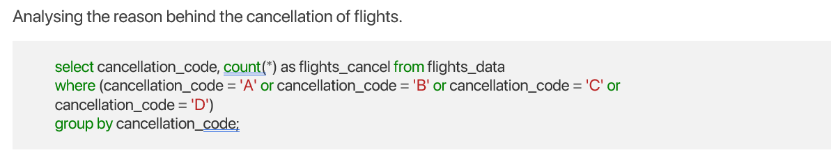
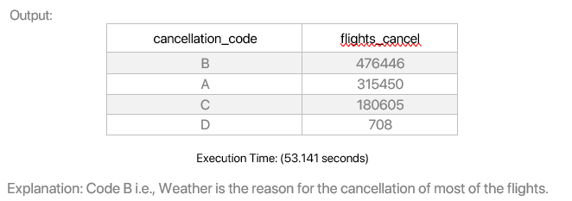
IBA MS Data Science
Big Data Analytics 2022
Working with Big Data
Insights of Data

Slide 30
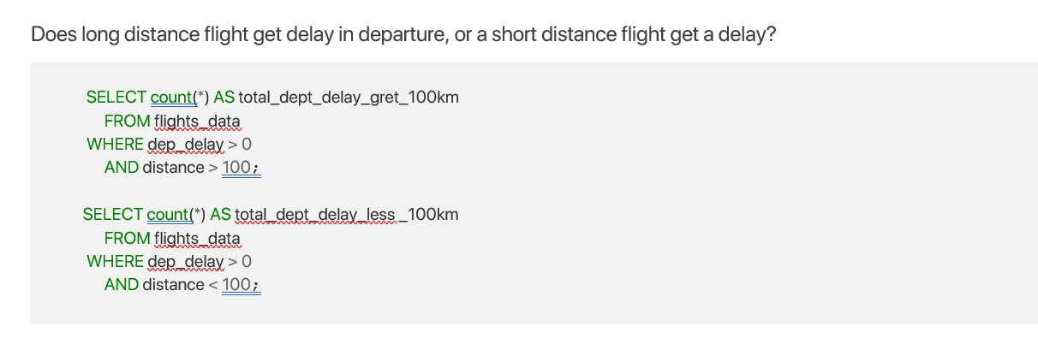
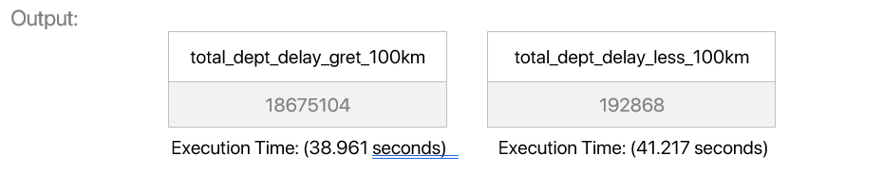
IBA MS Data Science
Big Data Analytics 2022
Working with Big Data
Insights of Data

Slide 31
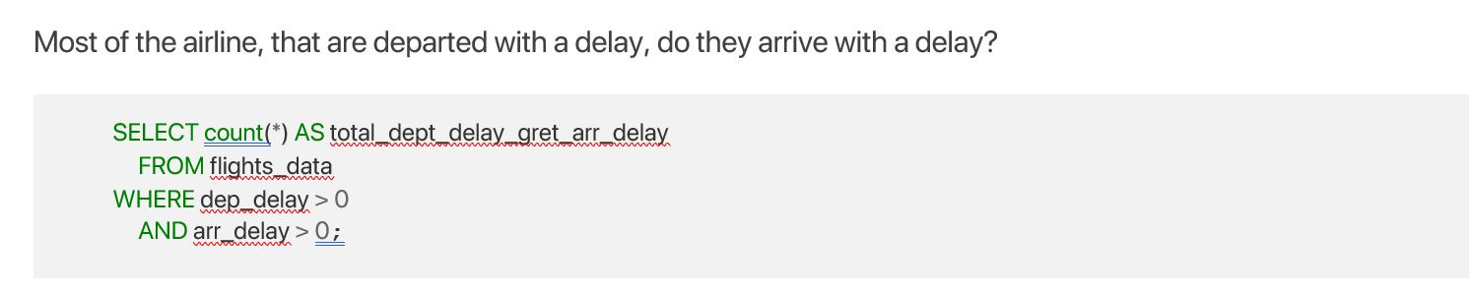

IBA MS Data Science
Big Data Analytics 2022
Working with Big Data
Insights of Data

Slide 32
Summary
Project
Initial Process
Apache HIVE guide
Working with Big Data
Containers Initialization
Handling Data Types
Copying Big Data
Bridge Networking
Databases
Creating Tables
Tables
Insights Flights Data
Partitions
…
Hivemall

Slide 33
thank you!

